Slide 1
Session 01
Introduction to Blockchain
Blockchain Protocols and Decentralized Applications

Slide 2
Expectations?

Slide 3
Course Objectives
Understand the fundamental principles of blockchain technology;
Differentiate between various blockchain protocols and their use cases;
Develop and deploy tokens, smart contracts on platforms like Ethereum and Arbitrum (bonus other chains);
Explore tokenomics and its impact on decentralized finance.
Build decentralized applications (dApps) integrating blockchain features.
Understand and interact with DeFi

Slide 4
Focus
Science & Technology of Blockchain
User experience vs Developer experience
Not about: hype, investment, trading, getting rich

Slide 5
Decentralization

Slide 6
What is web3?
The first era of the modern internet — roughly 1990-2005 — was about open protocols that were decentralized and community-governed. Most of the value accrued to the edges of the network: users and builders.
The second era of the internet — roughly 2005-2020 — was about siloed, centralized services. Most of the value accrued to a handful of large tech companies.
We are now beginning the third era of the internet — what many call web3 — which combines the decentralized, community governed ethos of the first era with the advanced, modern functionality of the second era. This will unlock a new wave of creativity and entrepreneurship.
Source: https://cdixon.mirror.xyz/0GBv9WRI-LQE6F4r2gGczG6AVeFlNuvt3HETHZ5A93U

Slide 7
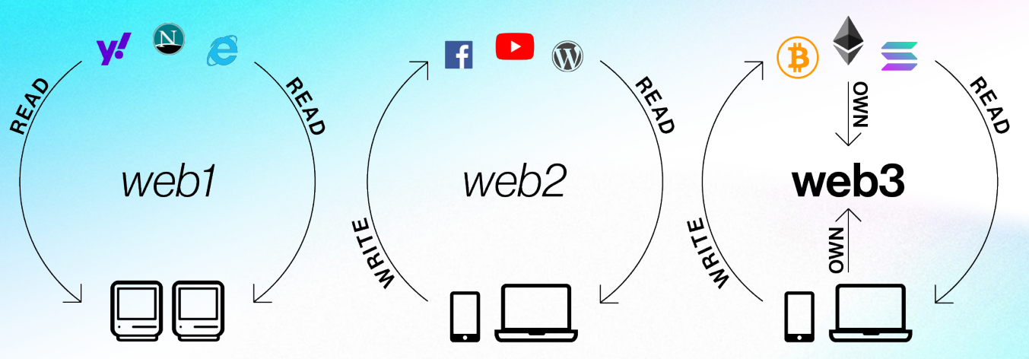
Web3
Source: ©2022 Andreessen Horowitz. All rights reserved worldwide

Slide 8
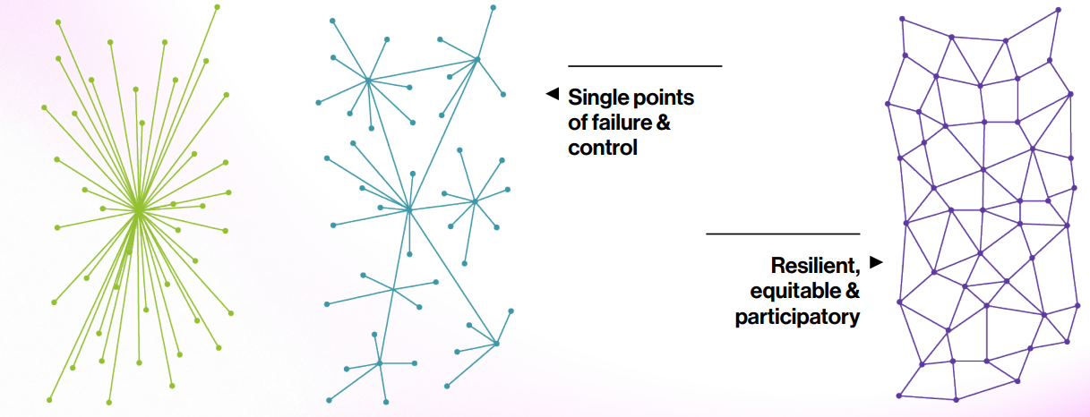
Web3
Source: ©2022 Andreessen Horowitz. All rights reserved worldwide

Slide 9
Blockchain
Network that:
No one owns it
Anyone can use it
Use cases:
Money: Bitcoin
Computer: Ethereum
Filesystem: Filecoin
Exchange: Uniswap

Slide 10



Decentralization - Good or bad?

Slide 11
Blockchain - Positive sides
Trustless Transactions - No need for intermediaries
Enhanced Security - Cryptographic principles ensure data integrity
Transparency - All transactions are publicly recorded
Efficiency - Streamlined processes reduce costs and time
Innovation - Enables new business models and applications

Slide 12
Blockchain - Negative sides
Scalability
Lack of Recourse - No “Forgot password”
Governance - Who makes the calls?
Efficiency - One action made by multiple entities

Slide 13
Bitcoin & Pizza

Slide 14
Bitcoin
https://bitcointalk.org/index.php?topic=137.msg1195
May 18, 2010, 12:35:20 AM
“I'll pay 10,000 bitcoins for a couple of pizzas.. like maybe 2 large ones so I have some left over for the next day. I like having left over pizza to nibble on later. You can make the pizza yourself and bring it to my house or order it for me from a delivery place, but what I'm aiming for is getting food delivered in exchange for bitcoins where I don't have to order or prepare it myself, kind of like ordering a 'breakfast platter' at a hotel or something, they just bring you something to eat and you're happy!
I like things like onions, peppers, sausage, mushrooms, tomatoes, pepperoni, etc.. just standard stuff no weird fish topping or anything like that. I also like regular cheese pizzas which may be cheaper to prepare or otherwise acquire.
If you're interested please let me know and we can work out a deal.”

Slide 15
Bitcoin
https://bitcointalk.org/index.php?topic=137.msg1195
May 21, 2010, 07:06:58 AM
“So nobody wants to buy me pizza? Is the bitcoin amount I'm offering
too low?”

Slide 16
Bitcoin
https://bitcointalk.org/index.php?topic=137.msg1195
May 22, 2010, 07:17:26 PM
“I just want to report that I successfully traded 10,000 bitcoins for pizza.”

Slide 17
Bitcoin - Medium of Exchange
May 22, 2010 - $41
$20.50 per pizza
Oct 3, 2024 - $600.000.000
$300.000.000 per pizza

